Slide 1
Teaching cybersecurity: a practical path to increase user’s awareness
BROKEN ACCESS CONTROL – BEGINNER LEVEL

Slide 2
ACCESS CONTROL
Grant or restrict users’ rights on the application
Ensure that users cannot act outside their intended permissions

Slide 3
ACCESS CONTROL
Authentication
Session management
Identify the users
Bind HTTP requests to users

Slide 4
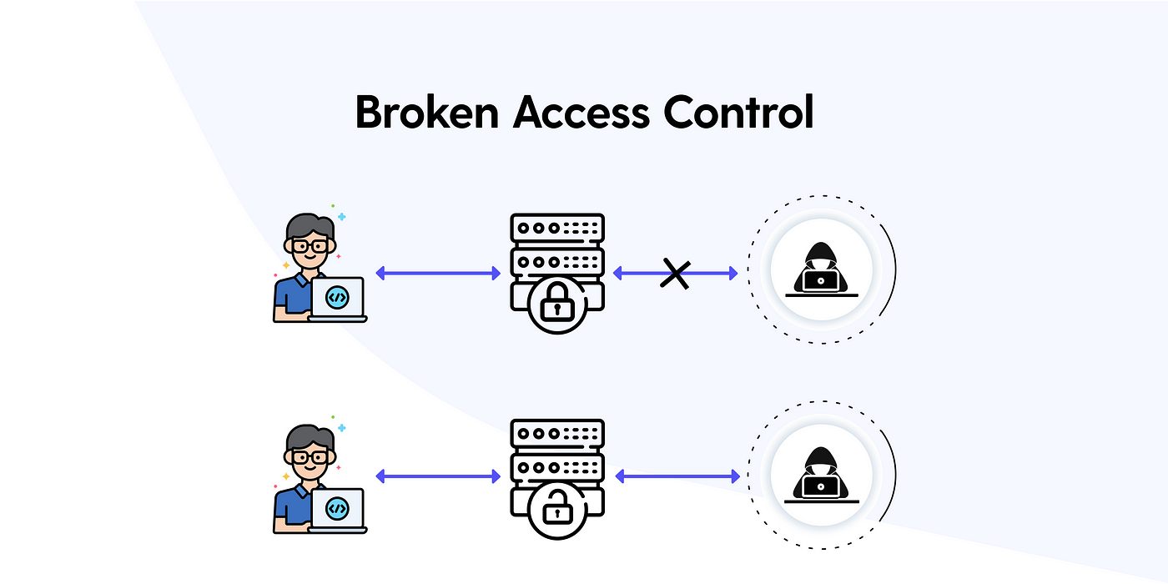
https://miro.medium.com/v2/1*3z3zxJj_GzArgT2SIy529w.png.

Slide 5
CONSEQUENCES
Modification or destruction of data
Unauthorized information disclosure
Performing business functions outside user’s limit

Slide 6
Cross site request forgery
An attack that tricks the victim into submitting a malicious HTTP request to a target destination without their knowledge or intent, in order to perform an action disguised as the victim

Slide 7
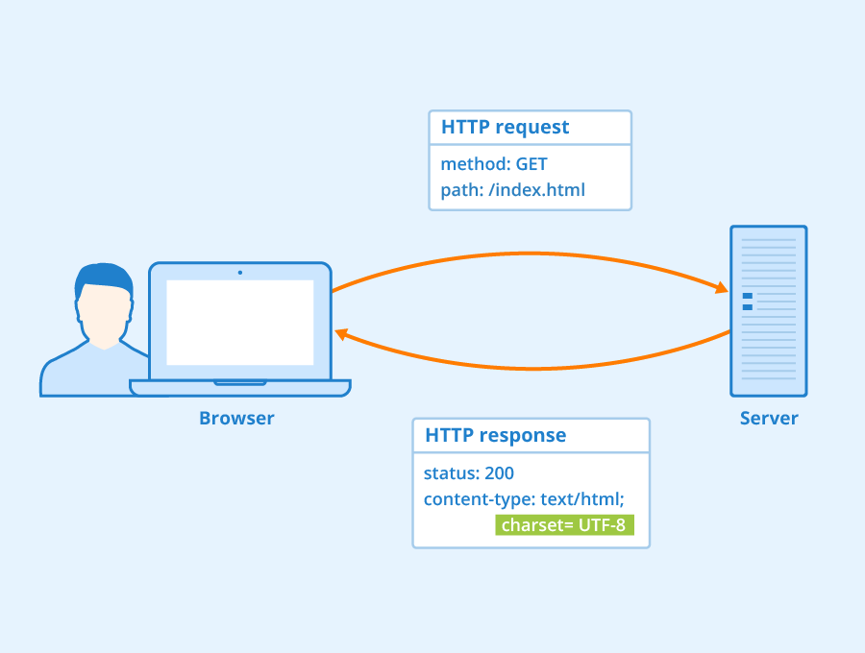
https://www.seobility.net/en/wiki/images/d/d2/HTTP-Header.png

Slide 8
http requests can be sent in different ways
Using the web application
Typing the URL in a browser
Following an external URL

Slide 9
CSRF NEEDS
A trusted site
A victim user of the trusted site
A malicious site

Slide 10
HAVE FUN WITH SOME PRACTICAL EXERCISES
Complete the suggested exercises of the Beginner Level of the Broken Access Control learning path

Slide 11
QUESTIONS
In this little section you will find some simple questions to test your comprehension of the topic.
Simply describe what “Access control” means
Name some of the problems Broken Access Control can lead to
Describe what Cross-Site Request Forgery is
What are the key actors necessary for a CSRF attack?

